Slide 1
SVM – Part 1
Rakib Mahmud

Slide 2
Introduction
It is fall under supervised learning and use for classification and regression analysis.
Model Training
Model
New Data
Output

Slide 3
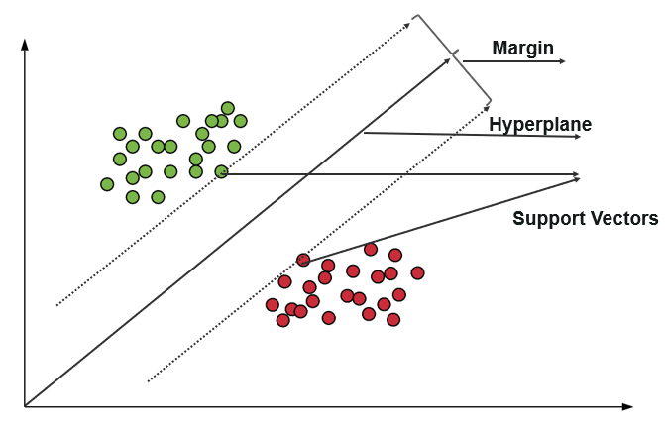

Slide 4
Key Concepts
Hyperplane: A decision boundary separating different classes in feature space.
Support Vectors: The closest data points to the hyperplane, crucial for determining the hyperplane and margin in SVM.
Margin: The distance between the hyperplane and the support vectors. SVM aims to maximize this margin for better classification performance.

Slide 5
Fig2
Fig1
m1
m2
Reject
Select

Slide 6
Why is maximizing it important for classification?
A bigger margin is better because it creates more space between the classes, making predictions more reliable.
A larger margin ensures that the model doesn't just memorize the details of the training data, like noise and outliers but instead focuses on the overall separation between the classes.

Slide 7
Thank You

